Slide 1
Cornerstone Success Center (CSC)
Registration and Training Content

Slide 2
Create an Account in the the Client Success Center (CSC)

Slide 3
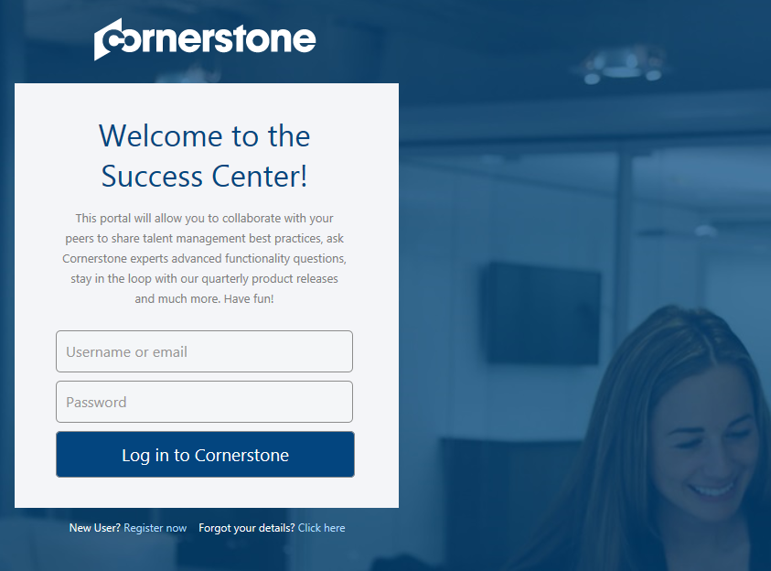
Self Registration
https://clients.csod.com
Click on the Register Now link and enter your information
After you complete the Self Registration Form, you will have immediate access to training and most events and sessions
Register now link
Notes:
We should all be familiar with the current Core Principles that we share with clients. These key principles are client facing and represent the key actions and activities

Slide 4
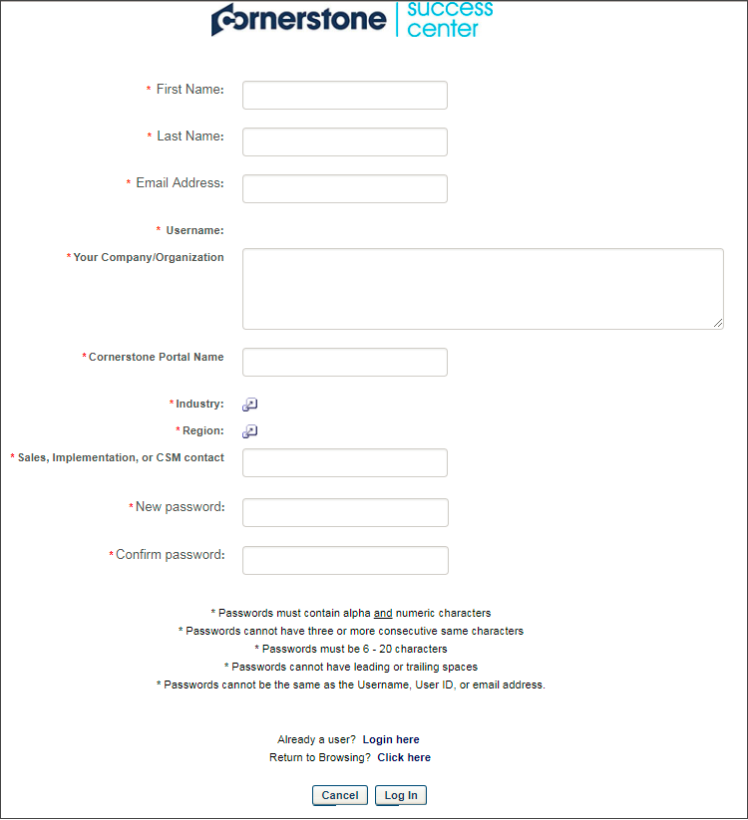
Self Registration Form
Complete the Self-Registration form:
Username will default to the email address you entered
Open comment box for Company name for further validation.
Portal Name - cccpln
Choose from the available list of options in Industry and Region
Sales, Implementation, or CSM Contact is Shaunagh Bedford
Click Log In and you will be taken directly to the CSC homepage
Notes:
Reminder to client to use the CSC actively, during implementation

Slide 5
Finding Training Content

Slide 6
Access Learning Resources
From the welcome page, select Resources from the LEARN menu
Notes:
Notes:
To Access Learning Resources Direct Clients to click Learn and choose Resources

Slide 7
Learning Resources
RELEASE RESOURCES – links to the Connect topic for the most current quarterly release, giving you access to a wealth of information and resources
LIVE TRAINING – links to information regarding live training service offerings from Cornerstone University
CERTIFICATION – links to information regarding certification programs offered by Cornerstone University
ONLINE HELP – links to Cornerstone system online help
LEARNING COMMUNITY – links to the Connect Topic created for clients in implementation who are learning Cornerstone via the online course libraries
Notes:
Learning Resources are broken into 5 categories:
Release Readiness – provides content and information regarding updates related to our quarterly releases
Live Training- points you in the direction to request in-person training
Certification- links to information on how to get certified in our product *note – we recommend certification after a client has experience within the system
Online Help- Links to our Online Help Page where a client can access documentation that helps further develop knowledge around the system
Learning Community- links to the Learn Community where you can collaborate with others, ask questions and share knowledge

Slide 8
Access Learner Home
From the welcome page, select Learner Home from the LEARN menu

Slide 9
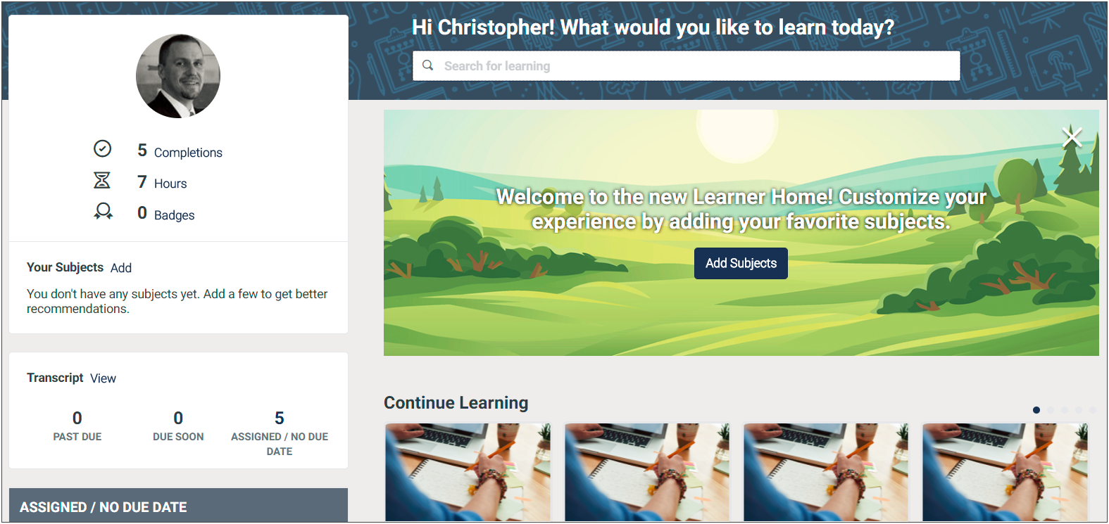
Accessing Learning Content:
Learner Home gives you access to:
Search and register for training content
Launch training that you have already registered for
See top picks for you based on your learning history and trending content
Notes:
To find content we encourage clients to take advantage of Learner Home. Here, you can search and register for trainng content, launch training you have registered for and see topics based on your learning history and what is trending

Slide 10
Available Learning Programs in CSC
The Cornerstone Success Center has several training opportunities. TO start your implementation you will only need the following 3.
Learning Program Title | Description
Cornerstone Core Fundamentals - System Administrator Training | Contains all of the courses to help system administrators configure and set up their system for the Core functionality.
Cornerstone Learning Fundamentals - System Administrator Training | Contains all of the courses to help system administrators configure and set up their system for the Learning Management System functionality.
Connect Fundamentals | Contains all of the courses to help system administrators configure and set up their system for the Compensation functionality.
Notes:
Compensation Fundamentals Available on 10.30
Connect Fundamentals Available 10.30

Slide 11
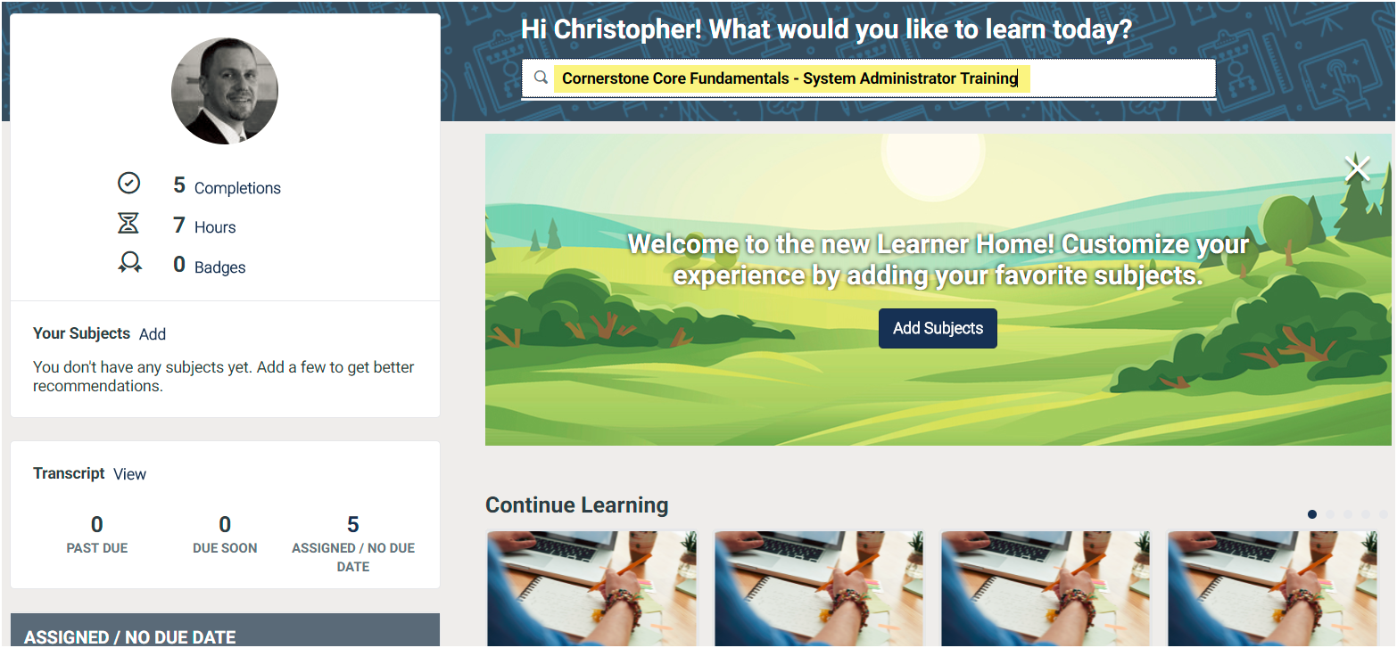
Register for Learning - Step 1
From learner home, enter the title of the program from the previous page. In this example, we will be using Cornerstone Core Fundamentals - System Administrator Training.

Slide 12
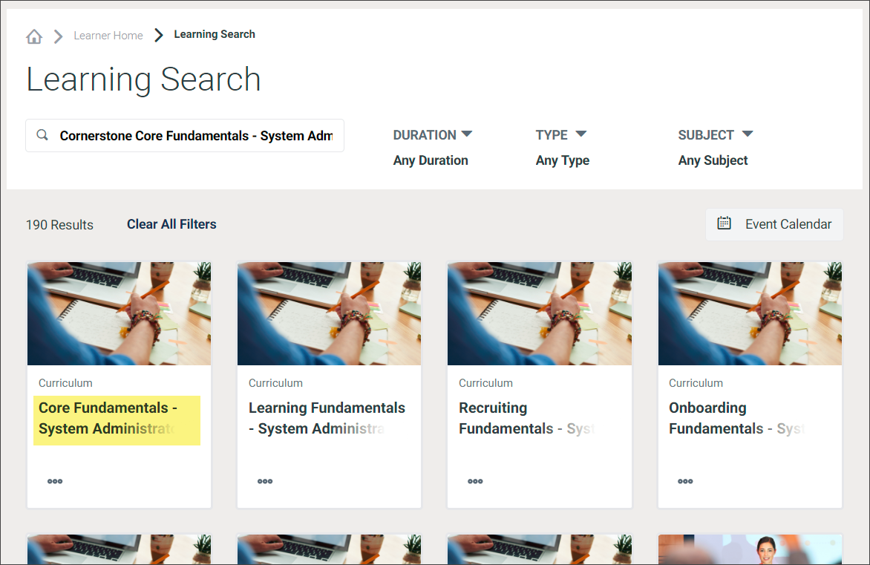
Locate Learning - Step 2
You are redirected to the Learning Search page with results. Click the title of the curriculum in the results.

Slide 13
Register for Learning - Step 3
You are redirected to the Training Details page for the curriculum selected. You can scroll down the page to see more details and a list of the learning objects contained in the curriculum. Click the Request button to register.

Slide 14
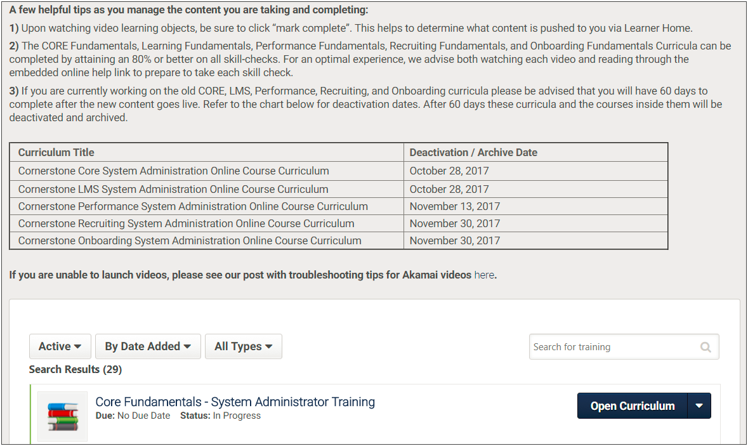
Register for Learning - Step 4
You are redirected to your Transcript. Please take note of the helpful tips referenced a the top. Click the Open Curriculum button for the newly added learning to open the program.

Slide 15
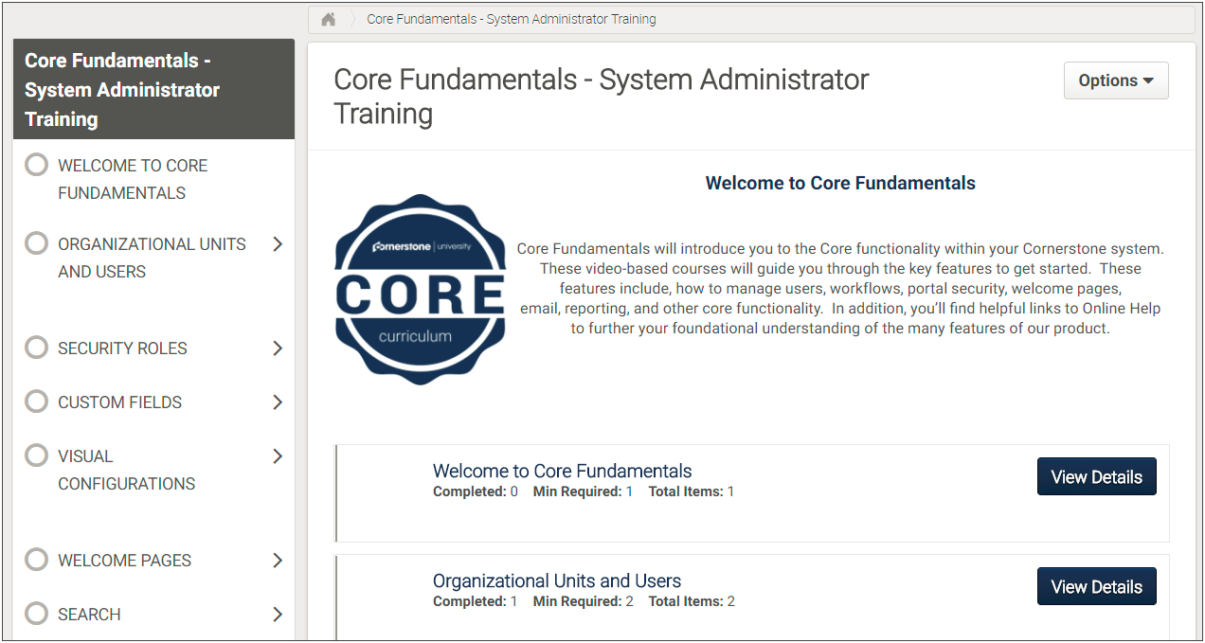
Register for Learning - Step 5
You are redirected to the Curriculum player. Curricula are divided into sections and learning objects nested within each section. Click view details for a section to see the learning objects associated to it.

Slide 16
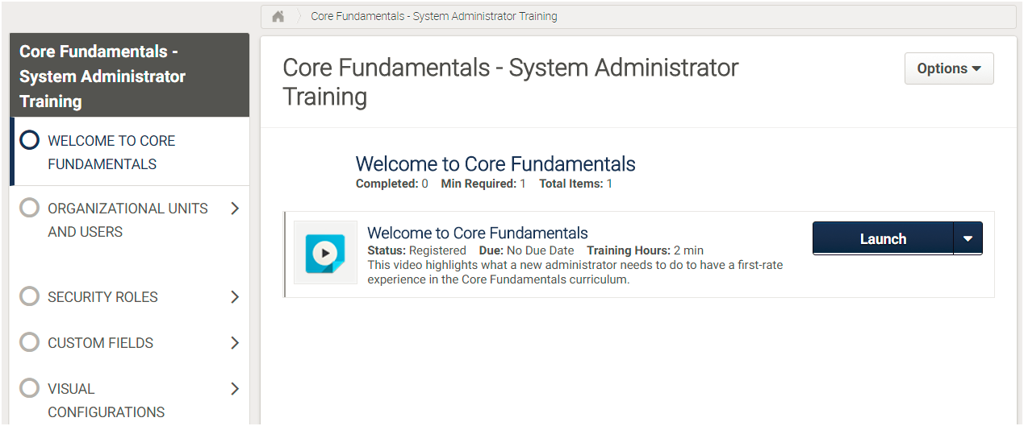
Register for Learning - Step 6
Inside a section, click the Launch button for each learning object to open. Remember to select Mark Complete after watching Video learning objects to track your progress. As you complete the learning objects, the curriculum will display your progress.

Slide 17
Training Focus – To be completed before you attend your 2 Day Admin Training

Slide 18
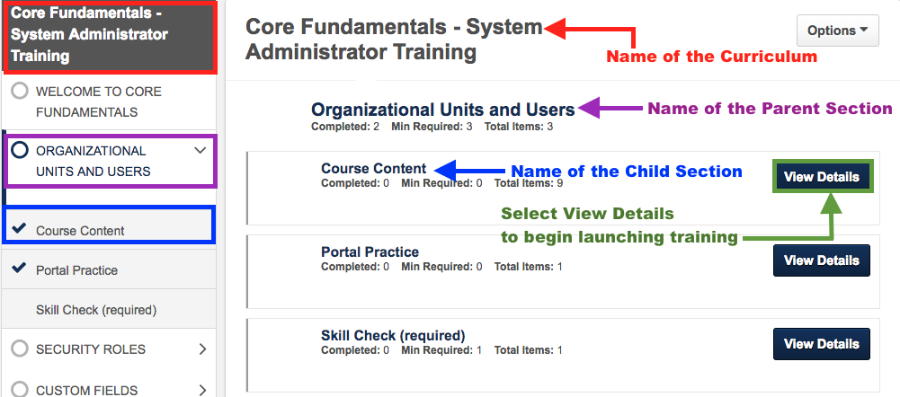
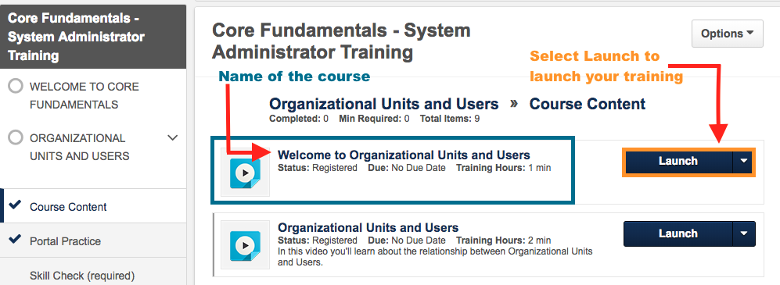
Step 1 - Understanding your Curriculum
Our focus will be the Course Content Section. Once you select View Details you’ll get this view to begin your training.

Slide 19
Curriculum - Core Fundamentals - System Administrator Training
Note – Do not be overwhelmed most videos are very short from 1-3 minutes in length.
Parent Section | Child Section / Title | Length in Minutes
Welcome to Core Fundamentals | Welcome to Core Fundamentals | 2
Organizational Units and Users | Section – Course Content
 | Welcome to Organizational Units and Users | 1
 | Organizational Units and Users | 2
 | Organizational Units and User Hierarchy | 2
 | Understanding the User Record | 3
 | Groups | 3
 | Creating Groups | 5
Welcome Pages | Section – Course Content
 | Welcome Pages | 1
 | Building a Welcome Page | 5

Slide 20
Curriculum - Cornerstone Learning Fundamentals - System Administrator Training
Note – Do not be overwhelmed most videos are very short from 1-3 minutes in length.
Section | Training Section (Please watch all videos under the Course Contents of each Section). We will do the skills check portion at our 2 Day Admin Training.
Learning Objects | Course Publisher Online Courses Materials Videos Instructor Led Training Test Engine Curriculum
Learning Experience Platform | Learner Home and Learner Search
Communication | Emails
Gather Data | Reporting on your LMS
Managing your LMS | Course Catalog Approval Workflow Learning Administration

Slide 21
Additional Resources
Additional Resources | Accessing Resources
Practice SCORM file for the content uploader | https://drive.google.com/file/d/1dufhHFTiObfiNz1xGC7zT4SiZJTS1qoL/view?usp=sharing
Quick Start Guides | https://drive.google.com/drive/folders/1_pOppmNtOv9EkS0YfwJPkeckEXBi0o0G?usp=sharing
Most Commonly Asked Questions | Coming Soon
Support help email | sbedford@appirio.com

